Slide 1


CSC-256 Group Project
December 11th 2024
Connor Mayer
Nya James
Carlos Rivas
LIBRARY MANAGEMENT SYSTEM
Aaron Thomas Jones
John Huestis

Slide 2
INTRODUCTION

Slide 3


PURPOSE
This system was developed by a Agile dedicated team to make library management seamless and efficient. We were able to break our responsibilities into week-long sprints.
It supports book cataloging, user account management, and a straightforward borrowing system.
This application allows users the ability to explore a wide range of books, manage their library accounts, and borrow resources with ease.

Slide 4
2024
KEY FEATS
1. Browse the catalog to discover available books.
2. Sign up for an account to start borrowing books.
3. Log in to view or manage your checked-out books.
4. Use our search functionality to find your preferred book.

Slide 5

2024
DATABASE
our database schema contains tables primarily structured around DJANGO’s default authenication and session management, along with a custom user model and a catalog for books.

Slide 6

2024
DATABASE
accounts_customuser: stores user data, including personal details.
catalog_book: represents books in the catalog.
accounts_customeruser_groups: Links users to groups.
accounts_customeruser_user_permissions: Links users to permissions.
auth_group_permissions: Maps groups to permissions.

Slide 7

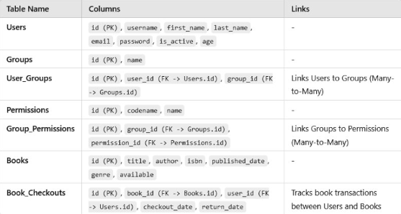
DATABASE SCHEMA
OUR DATABASE SCHEMA INCLUDING TABLES AND RELATIONSHIPS

Slide 8

TECHNOLOGIES USED
HTML / CSS
DJANGO
PYTHON
Our Front-end is made-up using HTML and CSS. Using templates; we were able to bring our application to life.
For its built-in resources that best suited the development of our application.
For it’s built-in libraries that assisted in our testing process, and it’s ability to program using DJANGO.

Slide 9
cSC256
2024
TECHNOLOGIES USED PT. 2
GIT / GITHUB
VISUAL STUDIO CODE
For it’s version control capabilities.
As our IDE of choice.

Slide 10
PROJECT GOALS

Slide 11




PROJECT GOALS
COLLABORATIVE DEVELOPMENT USING AGILE PRINCIPLES
AUTOMATED TESTING TOOLS
USER-FRIENDLY AND EDUCATIONAL LABS
70-80% TEST COVERAGE

Slide 12
TESTING STRATEGY
THE AUTOMATED TOOLS WE USED FOR QUALITY ASSURANCE
SELENIUM
PLAYWRIGHT
PYTEST
POSTMAN
ROBOT FRAMEWORK

Slide 13
CHALLENGES

Slide 14




CHALLENGES
SYNCHRONIZING TEAM EFFORTS REMOTELY
IMPLEMENTING ROBUST API INTEGRATION
ENSURING TEST COVERAGE ACROSS ALL MODULES

Slide 15

ACHIEVEMENTS
DETAILED DOCUMENATION AND EDUCATIONAL LABS
LOGIN AND MANAGEMENT FEATURES
75% TEST COVERAGE

Slide 16
EDUCATIONAL LABS

Slide 17
2024
EDUCATIONAL LABS
We’ve created five designated educational labs for students to be able to learn our testing strategies themselves.
Our labs were designed to replicate real-world applications of testing within our Library Management System Application.

Slide 18
LIVE DEMONSTRATION

Slide 19
EXPANDED FEATURES
MOBILE-FRIENDLY UI REDESIGN
OPTIMIZED PERFORMANCE
FUTURE IMPROVEMENTS

Slide 20

CONCLUSION
The library management System project demonstrated our ability to solve complex problems, collaborate effectedly as a team, and use advanced tools.
This project has prepared us for real-world software development scenarios and emphasized the importance of teamwork, planning and execution.

Slide 21
QUESTIONS?

Slide 22
THANK YOU

